Slide 1
STUDENTS FACING EXCLUZION SOCIALIZACION THE COMUNITY
G. Česnoviene
K. Juciene
D.Rainyte

Slide 2
Purpose:
To identify the problem of violence and bullying institution and its solution

Slide 3
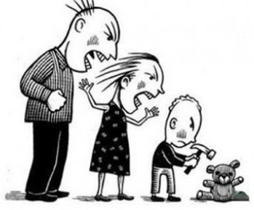
Aggression - behavior that is learned
negative experiences
the possibility to transfer the problem

Slide 4
Violence and Bullying
open
masked

Slide 5
Cyberbullying

Slide 6
Aggression, violence, bullying encourage:
other people's aggressive behavior
the desire for revenge
-negative physical, emotional experiences
frustration
fear

Slide 7
Fight against violence and bullying conditions
refusing to justify violence
unfavorable atmospheric violence and bullying Creation
justice and the norms of reciprocity formation

Slide 8
Fight against violence and bullying measures educational institution
"Week without violence and bullying"
the formation of positive social įgdžių
social workers, psychologists activity
teachers, group leaders activities
programs against violence and bullying implementation

Slide 9
Questions?
Projekto įgyvendinimui Europos Sąjunga suteikė finansinę paramą. Jame atspindėtas Dotacijos gavėjo požiūris, o Švietimo mainų paramos fondas ir Europos Komisija nėra atsakingi už pateikiamos informacijos turinį.

